Slide 1
Module 2 Biology and Water Chemistry

Slide 2
Module Objectives
Participants will understand the basics of biology and water chemistry relevant to biological and physiochemical processes affecting fish growth, recruitment, fish feed.
Therefore these factors indirectly impact upon biological productivity of the rice field and CFR ecosystem.

Slide 3
Important parameters for increasing productivity and biodiversity
The most important factors will be :
temperature
pH
turbidity
Temperature and pH will be fairly constant and not require mitigation measures
The mineral turbidity will be most important factor affecting productivity
To improve water productivity nitrates and phosphate concentrations important

Slide 4
1. Water Temperature
The optimal thermal range for most warm water fish is 23 to 32ºC but 27-30ºC is preferable to growth for most species.
Temperature affects: growth, maturation of brood fish, egg development and juvenile growth.
Low temperatures cause infections and disease.
In warm water, fertilizers dissolve faster, herbicides act quicker, and the rate of oxygen consumption by decaying manure is greater.
High temperature also affects respiration and fish do not grow so well

Slide 5


Water Temperature and Depth
0.5
1
1.5
Thermocline
2.
2.5
3.
Temperature variation at different depth pond (source , Rous 1979)
In deep CFRs the bottom and mid-water fish may live in water outside their optimum thermal range

Slide 6
Temperature management
High temperature in CFRs can be mitigated
by deepening the pond
planting tree to create shaded areas
planting aquatic plant - see Module 3 for the type of aquatic plant and ideal coverage of the pond

Slide 7
2. Dissolved Oxygen (O₂)
Important for
Respiration (breathing) of all animals
Decomposition of organic matter
In the water
DO is less on cloudy days (less sun light)
Completely stops at night
Lowest concentration in the early morning (around 4 to 6 am.)

Slide 8
Relative Dissolved Oxygen concentrations for high and low plankton densities over time
Lowest D.O for Common Carp
Lowest D.O for African Catfish
(source , Rous 1979)

Slide 9
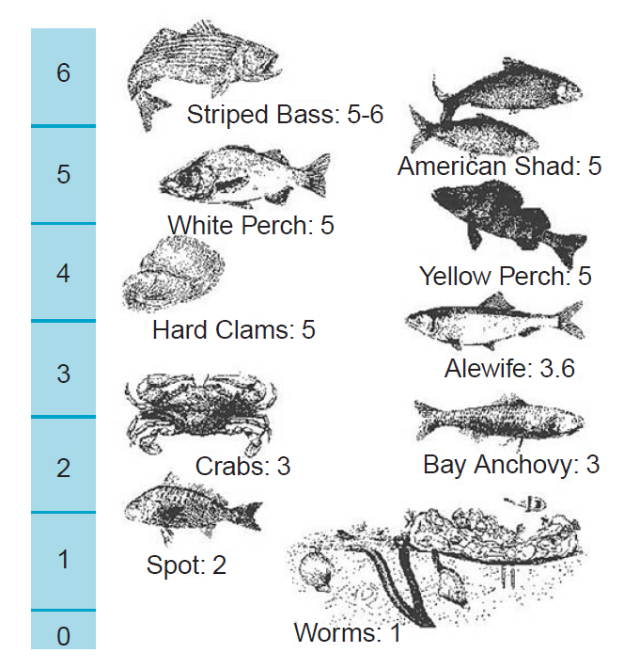
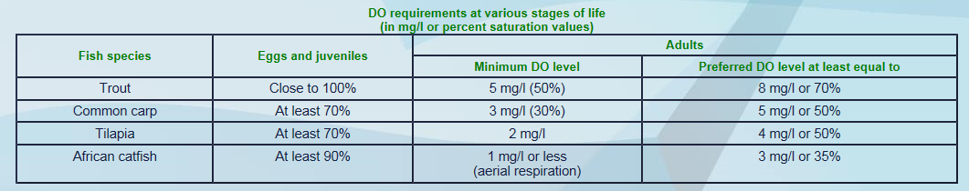
DO concentrations for different species
The DO tolerance varies for different species
The catfishes are the most tolerant to low DO
Black fish are more tolerant than grey and white fish
The carps least tolerant.
Important for selecting fish species for different CFRs
DO(mg/l)

Slide 10
DO observation & management
Since in CFR’s and rice fields the biomass of fauna (quantity of fish) is usually not high, there is usually sufficient DO.
Observation
However if fish gulp air on surface in the morning, it means carrying capacity for DO is reached
Actions
The following options prevent mass fish kill:
Stop adding fertilizer if relevant
Flush with new water by opening inlet if possible
Remove fish
Never reduce water volume when fish gulping air

Slide 11
3. Potential Hydrogen (pH) (1)
The concentration of Hydrogen ions in water is better known as acidity and basicity:
pH 7 is neutral
pH below 7 is acid and pH above 7 is basic
When pH is 7 neutral water is good for fish but when water becomes acidic or basic the fish need to expend more energy.

Slide 12
Potential Hydrogen (pH) (2)
The pH is a measure that indicates whether the water is acidic or basic in reaction.
As for DO, pH varies during the day
(source , Rous 1979)

Slide 13
pH suitable for fish
Correction needed
Correction needed
If the water body is outside the acceptable range fish will grow more slowly and may not reproduce.
(source , Rous 1979)

Slide 14
pH management
Most CFRs do not require mitigation measures to buffer or adjust the pH
In closed ponds lime may be added to buffer high and low pH but often this may be prohibitively expensive

Slide 15
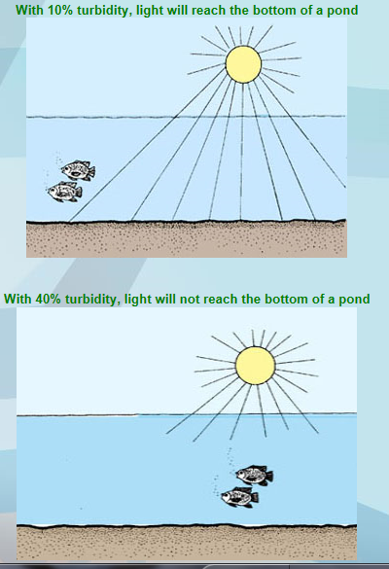
4. Water Transparency and Turbidity
Turbidity indicates a water contains suspended materials which interfere with the passage of light.
Turbidity results from planktonic organism and suspended clay particles:
MINERAL AND HUMIC TURBIDITY

Slide 16
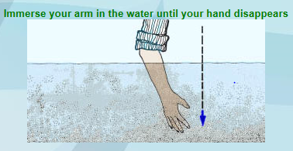
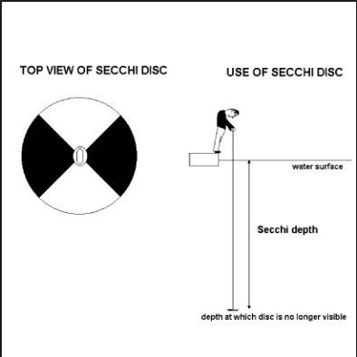
Humic Turbidity
The most ideal humic turbidity in standing water would be 30-45 cm visibility with arm or a Secchi disc.
30-45 cm visibility= good plankton density.
If too much plankton DO will be less (Low visibility)
If too little food for herbivorous fish may not be enough (Higher visibility)

Slide 17
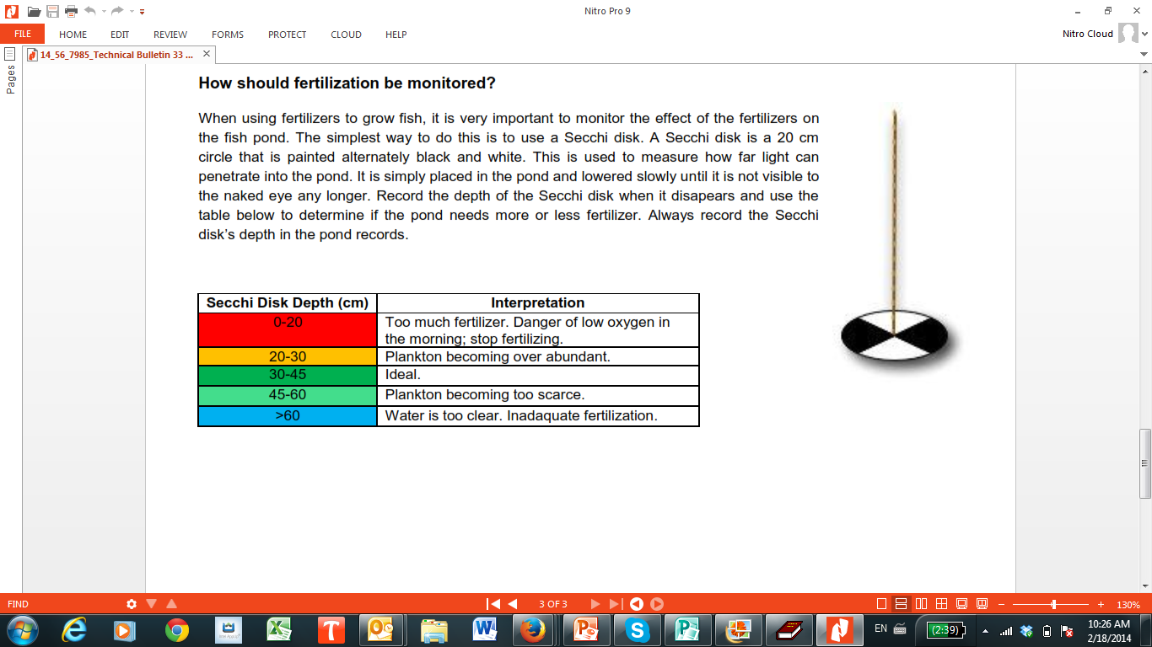
Green water
Green water with Secchi Disc at 30-45 cm is good for fish or see fingers when arm in water up to elbow.

Slide 18
Mineral Turbidity
The incidence of high turbidity from silt particles in suspension is currently one of the greatest factors affecting water productivity in CFRs.
High turbidity:
Prevents plankton growth and food for other small fish.
Reduces DO for fish to ‘breathe’
Reduces sunlight to breakdown organic materials resulting in anaerobic muds building up.
Silts up water body reducing depth
Directly affects fish respiration by clogging gills
Kills delicate fish eggs and larvae.

Slide 19
Mitigation of high mineral turbidity
In fish ponds use fertilizer, lime and the aggregating chemicals, alum (aluminium sulphate) and gypsum (magnesium sulphate).
Too expensive for CFR?
Prevention by reducing entry of turbid water and erosion of banks during rains will be best measure, with vegetation cover for example

Slide 20
5. Nitrate and Phosphate
Nitrogen and Phosphorous are important elements for plankton growth, with the best ratio 4N:1P
This combination is best achieved by application of fertilisers; but it may also come from agricultural run-off and from fish and other animals in the water body
A high accumulation of nutrients in water especially N and P is known as eutrophication

Slide 21
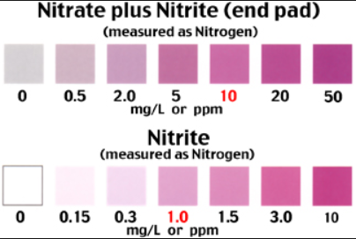

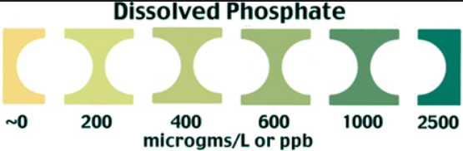
i)-Ideal nitrate level (NO3) is 0.1 mg/L to 4 mg/L ii)-Ideal phosphate levels is around 0.06 mg/L

Slide 22
6. Feed sources for RFF species
More food = more fish = more production (kg/ha)
How can we increase food for many different species of fish? There are 3 types of food
Natural Food: detritus, bacteria, plankton, worms, insects, snails, aquatic plants and fish.
Supplementary Food: consist of cheap materials locally available such as terrestrial plants, kitchen wastes or agricultural.
Complete Food: They are made from a mixture of carefully selected ingredients to provide all the nutrients necessary for the fish to grow well (commercial food).
Only enhancing Natural Food is practical for RFF/CFR

Slide 23
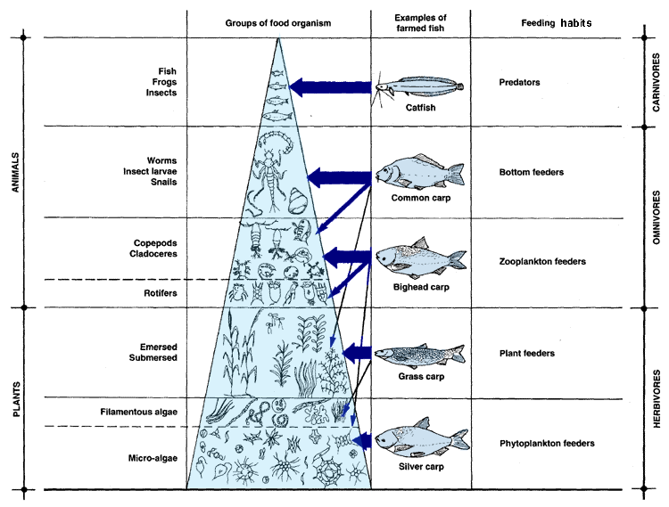
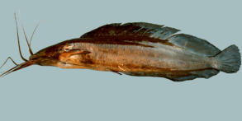
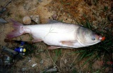
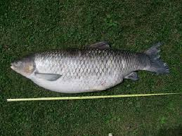
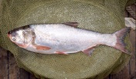
Example of feeding ecologies of catfish and Chinese carps

Slide 24
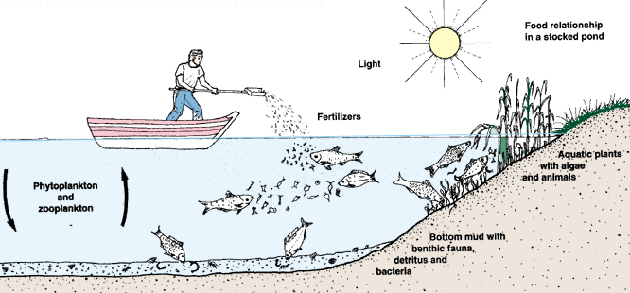
Example of ideal aquatic ecology

Slide 25
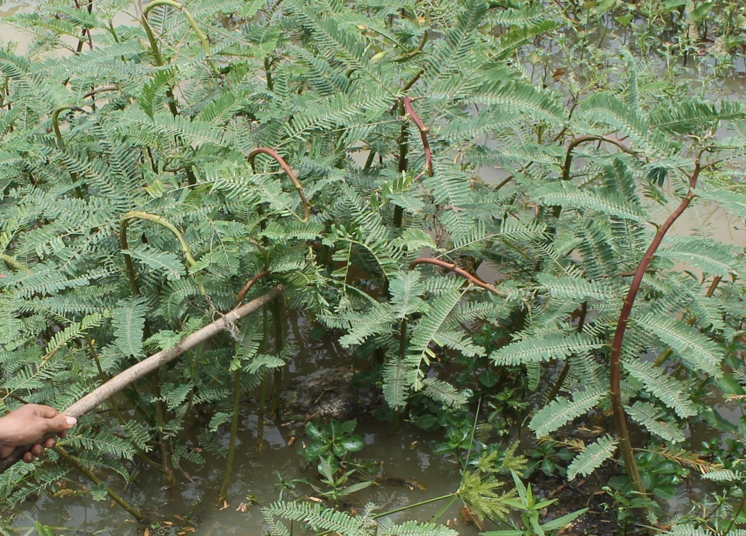
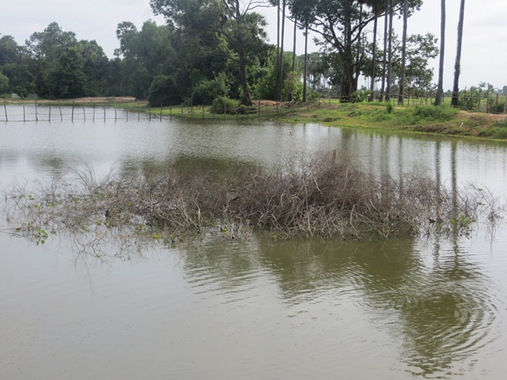
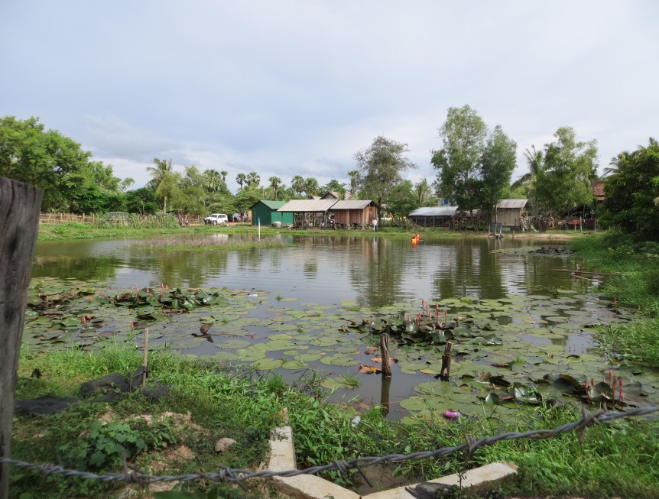
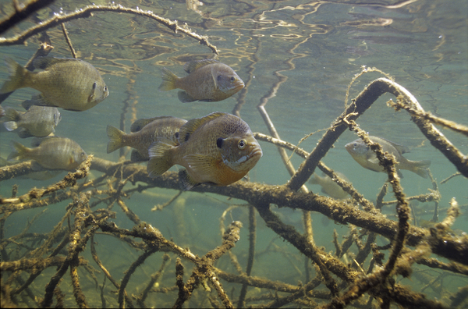
6. Fish Habitat in CFRs
Samrash
Fish shelter provides breeding ground, shelter, feeding ground and hiding place.

Slide 26
Monitoring Water quality
Parameters to monitor and material:
Temperature (digital thermometer);
Phosphate and nitrate (test kit)
pH (test kit)
Turbidity (Sechhi disk)
Frequency : 4 times per year :
1st sample: end of July
2d sample: 1st week of October
3rd sample: last week of December
4th season : Around Khmer new year

Slide 27
Water sampling
When: mid- day (11:00 am to 13:00 pm).
Where:
10-20 meters from the shore in 6 different locations around the CFR.
30 cm below the surface with a 500 ml bottle previously rinsed with water from the CFR.
All samples are mixed in a bucket
A single 500 mL sample is used for analysis for pH, total phosphate and nitrogen
Temperature is measured at the points where the water sample are taken, the six measurement are averaged

Slide 28
Data recording
Excel spreadsheet: Water_quality_monitoring
Average data for temperature, turbidity
CFR Name | Occasion | Date | Start time | Name of Investigator | Water Temperature | Secchi depth (cm) | pH | Phosphate | Nitrogen | Notes

Slide 29
References
FAO Training Series, chapter 6, 10.
R. Dennis Rouse, 1979; Water Quality Management In Pond Fish Culture.
# 33-HARVEST technical bulletin.

